Slide 1

Week 7 Status Report
Split up into 2 teams: UI and Back-end
Currently 1 week into our first 2 week sprint

Slide 2
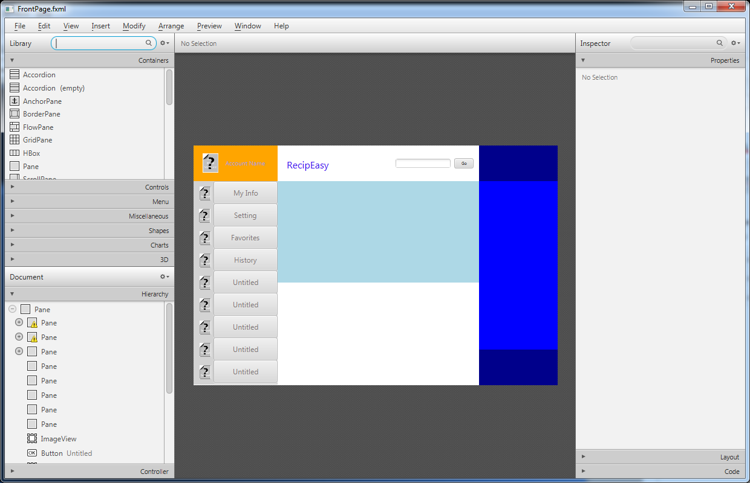
UI Team
Making the GUI in JavaFX Scene Builder

Slide 3
Back-end team
Currently using the jsoup java html parser to gather information from betty crocker
Working on serializing objects so that the UI team can integrate the backend objects into the GUI

Slide 4
Upcoming
By the end of our first sprint we hope to have a basic working version of RecipEasy
We also want to have a dummy database set up so the UI team can integrate some recipe objects

